Slide 1

Industrials
Jacob Hedenquist
Ian Cupello
Alyssa Allen
Carson Seramur
Dyer Whitehurst
Patrick Woodland

Slide 2



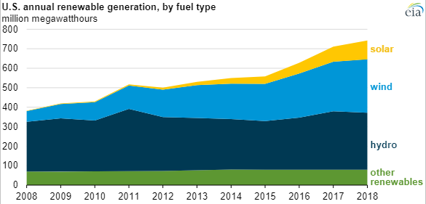
Renewables Industry Overview
Overall
Competitors
Most states require utilities to generate a portion of their electricity from renewable sources
Companies benefit from electricity production tax credits (PTC)
Increased opportunities for renewables due to state and federal policy initiatives
Renewable energy outpaced coal by providing 25% of the U.S. power in 2019
Renewables are becoming cheaper than ever for the consumer
Renewables saw significant demand from most market segments
1 out of every 3 Americans live in a community that has committed to or has achieved 100% clean electricity
Historical U.S. Renewable Generation
Sources: DOE, EIA
Analyst: Ian Cupello

Slide 3
Wind Industry Overview
Types of Wind Energy
How It Works
3 Types of Wind Energy
Utility Scale: Large turbines that contribute to a power grid and distributed to end user
Distributed or “small” wind: Used to directly power a home, farm or small business and are not connected to the grid
Offshore wind: Wind turbines that are constructed in large bodies of water, typically on a continental shelf
When wind blows past a turbine, its blades capture the winds kinetic energy causing it to rotate turning into mechanical energy
Rotation turns an internal shaft connected to a gearbox
Gearbox then spins a generator that produces energy
Turbines in a wind farm transport electricity to a power grid where utility companies can send people their power
Growing Industry
Innovation
Modern turbines are increasingly cost effective
Since 1999, average turbine generating capacity increased 180% to 2MW
Wind power market expected to grow at around 8% CAGR from 2020-2025
Decreasing fossil fuel reserves, declining cost for wind power, and support from governments
Emerging markets in Africa and South America offer robust business opportunities
Transition away from smaller wind blades provides an opportunity for companies to manufacture and replace old turbines
Turbine scale is inversely correlated with LCOE
Emergence of turbines capable of withstanding regions with low wind speeds
Wind blade represents 15% of the cost of a wind turbine
Sources: Bloomberg, Deloitte, DOE
Analyst: Ian Cupello

Slide 4
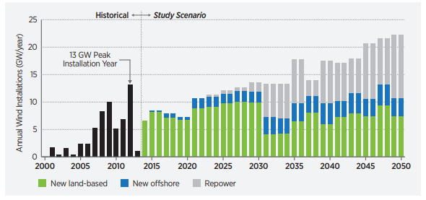
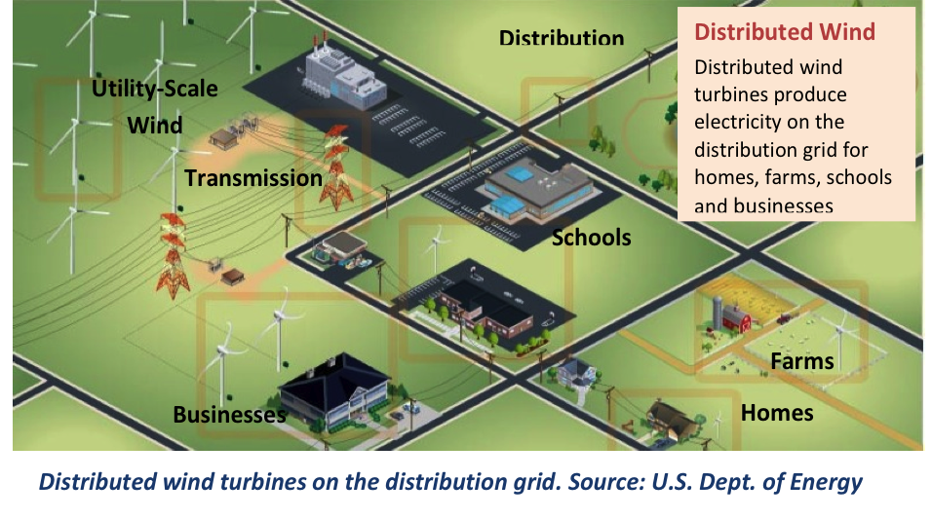
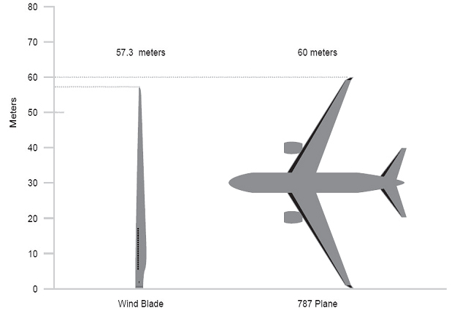
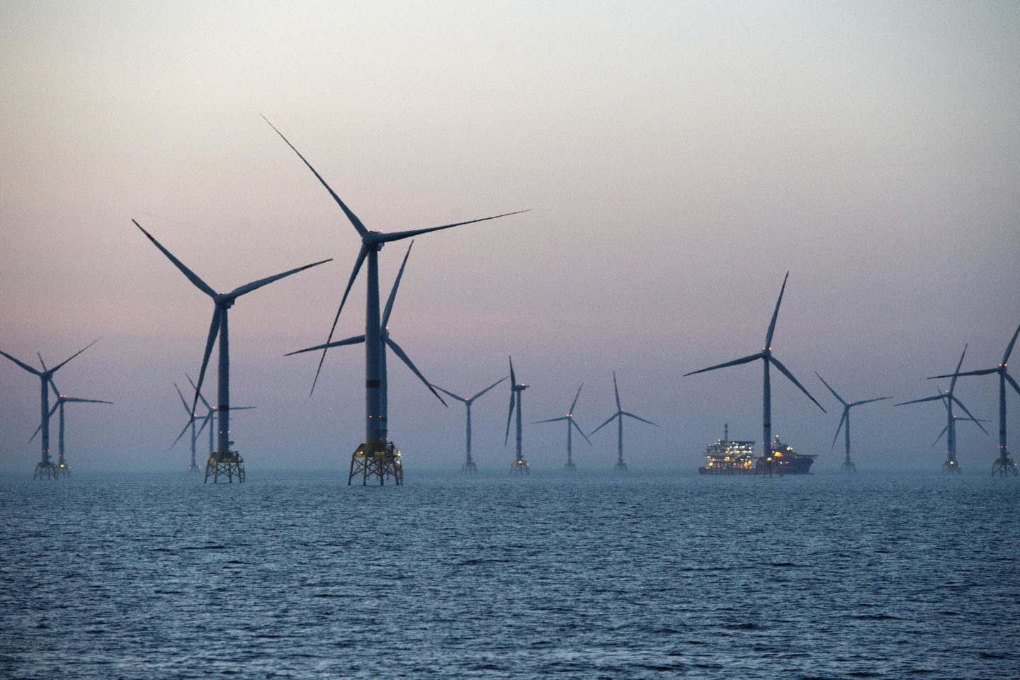
Wind Industry Overview
Wind Turbine Installations
Distributed Wind
Turbine Blade vs. 787
Offshore Wind
Sources: Department of Energy, TPI
Analyst: Ian Cupello

Slide 5




Company Overview
Company Overview
Management Team
TPI Composites primarily designs and manufactures composite wind blades for the wind energy market
Largest and only independent wind blade manufacturer
In addition, the company has begun to manufacture composite vehicle structures
Partnered with DOE to establish manufacturing techniques in the wind space
Customers sign long term supply agreements with minimum annual wind blade purchases
Steven Lockard, CEO
Ramesh Gopalakrishnan, COO
Bryan Schumaker, CFO
William Siwek, President
Long Term Supply Agreements
TPI Integrated Production System
Minimum annual volumes of 3 wind blade sets
Allows for revenue visibility and capital efficiency as well as lower delivered costs
As of 2019 LTSA total contract value is $6.8 billion up to 2023
5-7 year agreements
Contracts have termination clauses which require customer to pay fees for termination
Allows TPI to customize production process for customer preference
Manufacturing Process
Transfer resin into a dry lay-up
Fiber reinforcements and core materials are laid in a mold to dry
Resin introduced to blade mold which saturates the blade
Resin vacuum eliminates air from mold
TPI facilities allows for entire process to be changed based on customer specifications
Source: TPI 10k
Analyst: Ian Cupello

Slide 6
Company Overview
Revenue Segments
Customer Breakdown
Wind Blade Manufacturing
Produced 45,000 blades since 2001
Created the TPI Integrated Production System
Blades range from 30-70 meters in length but are capable to manufacture bigger blades
Precision Molding and Assembly Systems
Started in Rhode Island and expanded internationally
Recently Expanded to Mexico to serve LATAM market
Sales doubled from $27M to $48M
Transportation
Currently in beginning stages of developing this segment
Produces composite solutions to assist customers in developing electric vehicles and buses
2025 U.S. Government Corporate Average Fuel Economy standards have been beneficial
Supply agreements with Proterra and Navistar to design and promote fuel efficiency in commercial vehicles
Revenue Breakdown
Sources: Bloomberg, CapIQ
Analyst: Ian Cupello

Slide 7
Investment Theses
Rapidly Expanding Industry
Wind energy is a significant portion of the high growth renewables space
It is the fastest growing source of energy in the world since 1995 & is expected to double in capacity in the USA by 2030
The only efficient way to harvest wind energy currently is through traditional wind turbines that use intricate wind blades
Dominant Player in Space
TPI Composites is the only manufacturer of wind blades with global scale
Wind blades are becoming increasingly complex, leading turbine manufacturers to continue outsourcing
TPIC has active contracts with every major turbine manufacturer
Diversification of Revenues
TPI seeks to establish additional recurring revenue bases via the supply of composite technology and other structures outside the wind market
Management has set a long-term goal of $500M in transportation revenue
Transportation and Precision Molding & Assembly revenue segments have increased rapidly since 2017
Analyst: Carson Seramur & Jacob Hedenquist

Slide 8
Rapidly Expanding Industry
Explosive Growth
Primary Energy Consumption by Source
U.S. Energy Information Administration (EIA) projects that world energy consumption will grow by nearly 50% between 2018 and 2050.
EIA also expects “renewables” market share of energy usage to more than double by 2050 (19%->38%)
Within this growth, Solar & Wind Energy are expected to dominate market share of the renewables space (currently ~50% of renewables and expected to expand to ~80%)
renewables
petroleum
natural gas
coal
nuclear
Non-Substitutable Product
Growing Domestic Market
There is one major efficient way to harvest wind energy: traditional turbine and blade
Source: CapitaliQ, PowerTechnology, energy.gov, Bloomberg
Analyst: Carson Seramur

Slide 9
Dominant Player in Space
Lead Global Producer of Wind Blades
Wind Energy Capacity by Country (GW)
TPIC operates in the United States, Asia, Mexico, Europe, the Middle East, and Africa
Operates 4 major plants in strategic global locations (United States, China, Mexico, & Turkey) with a new plant to begin operations in India during Q1 2020
All direct comparable companies are micro-cap private firms such as: MFG Wind, Enercon, LM Wind Power (acquired by GE in 2017)
Geographic & Economic Moat
Results of Advantage
Wide geographic moat due to barriers to entry related to manufacturing (high fixed cost) and a sustainable competitive advantage rooted in intangible assets (long term contracts)
Wind Blades getting more complex (34% of blades were greater than 60 meters in 2018 and that is expected to grow to 87 in 2022), and as the blades get more complex it puts more pressure on OEMs to outsource
Third quarter earnings saw a 50.5% increase in net sales & 57.4% in adj. EBITDA
Dramatic increase is largely due to increased production in foreign markets (China, Mexico, and Turkey) and does not include the growth potential yet to be realized by the new plant being established in India
Source: CapitaliQ, PowerTechnology, energy.gov, Bloomberg
Analyst: Carson Seramur

Slide 10

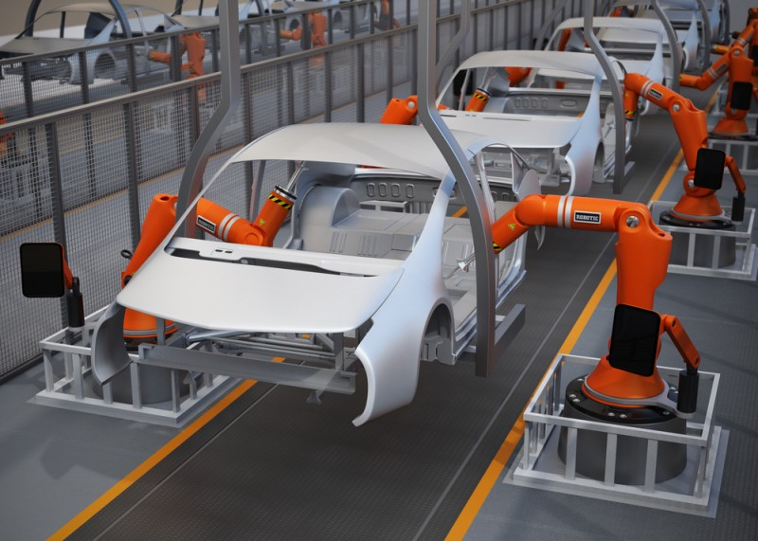

Diversification of Revenues
Transportation Market
Past Projects
EV market is projected to grow at a CAGR of 21.1% from 2019 through 2030
2025 U.S. Government Corporate Average Fuel Economy standards are pushing automakers to develop lighter, more fuel efficient vehicles with lower emissions
“Our long-term mission remains unchanged establishing… $500mm of transportation revenue.” – CEO Lockard (Q3 Earnings Call)
PM&A facilities in Rhode Island, China, and Mexico
Electric Vehicle Market Growth (MM)
Trans. and PM&A Revenue (MM)
Source: 10k, Bloomberg, Markets & Markets
Analyst: Jacob Hedenquist

Slide 11
Investment Risks
Operating at a Loss
TPIC reported a net loss per share of $0.13 during 3Q earnings
Concentrated Revenue Base
A reduction in purchase orders or supply agreement renewals could harm business
GE Wind (31.7% 2018), Vestas (32.0%), Nordex (19.0%), Siemens Gamesa (11.2%)
GE Wind bought largest competitor, LM Wind Power, in 2017 and is expected to slowly phase out its purchase of TPI blades
Phase Out of Government Tax Credits
The Production Tax Credit for Renewable Energy (PTC) has slowly been phased out since 2015
The loss of tax credits will increase costs for wind far owners and therefor decrease demand for wind turbine and blade manufactures in the US
Analyst: Carson Seramur & Jacob Hedenquist

Slide 12
Operating at a Loss
Risk
CapEx Over Time ($MM)
TPIC reported a loss in Q3 2019
EPS of ($0.13) per share
TPIC attributes operating at a loss due to significant start up costs & a significant one-time income tax provision ($18mm)
Majority of start up & transition Costs related to growth (85%)
Mitigation
Start Up Costs Over Time ($MM)
TPIC still maintains strong operational growth (Adj. EBITDA up 57%)
Start up costs expected to flatline or decrease as infrastructure is put into place
Business remains strong fundamentally with all previous headwinds priced into stock
Street still bullish on TPI Composites: 90% of covering analysts list the holding as an outperform/buy
Source: Bloomberg, CapitaliQ
Analyst: Carson Seramur

Slide 13
Concentrated Revenue Base
Revenue Breakdown by Customer
Revenue Breakdown in Context
TPI customers represent 54% of global onshore wind energy market, 90% of the market excluding china, and 99.8% of US onshore market
59% of all blades are outsourced, up from 38% in 2009
34% of blades were over 60 meters in 2018, expected to grow to 87% in 2022
Revenue Percentage by Customer
Mitigation
GE did not extend Turkey or China supply agreements which expired at end of 2017
GE extended Mexico contract through 2022 and increased lines under contract to 5 per year
GE transitioned to a larger blade model in Iowa plant in early 2019 and eliminated the termination option
TPIC’s average GE revenue growth rate since 2017 is negative 5.95% compared to all other customers at positive 45.57%
Source: 10K, WoodMac
Ana: Jacob Hedenquist

Slide 14
Phase Out of Government Tax Credits
The End of Tax Incentives
Enforced Moat for Incumbents
PTC provided wind farm owners with 10-year tax credits of roughly $24/MWh
In 2015, Congress set in motion a plan to phase out these tax credits over a 5 year horizon
It is expected that costs will rise for wind energy producers, and therefor decrease demand for turbine and blade manufacturers
Most international countries TPI does business in have already moved away from tax credits
As large incumbents are already selling big volumes worldwide, the phase out of PTC is expected to disproportionally hurt smaller players furthering TPI’s economic moat
The multi-year PTC phase-out has given the market unprecedented visibility, breaking from its historic pattern of short term expirations and renewals
Internationally, countries like China, Mexico, EU players, Turkey, have declared minimum renewable energy requirements
U.S. Tax Credits vs. Wind Capacity
U.S. Tax Credits vs. LCOE
Source: 10k, Novoco, Lazard
Analyst: Jacob Hedenquist

Slide 15
Relative Valuation
Forward P/E
EV/EBITDA
Current P/E
EV/Revenue
Sources: Bloomberg, Cap IQ
Dyer Whitehurst

Slide 16
Intrinsic Valuation – DCF Inputs
Assumptions
WACC
Beta
Analyst: Alyssa Allen
Sources: Historical Price Data, Company Filings, CapIQ

Slide 17
Intrinsic Valuation – DCF Base Case (Calculated WACC)
Analyst: Alyssa Allen
Source: TPIC Bull DCF

Slide 18
Football Field
Conclusion
Target Range: $23 to $30
Rapidly Expanding Industry
Dominant Player in Space
Diversification of Revenues
2/4/2020 Price: $21.44
Implied Trading Discount:
7% to 40%
DCF: Upside Range
$31.77
$56.08
DCF: Downside Range
$13.85
$36.96
DCF: Base Range
$22.28
$45.96
52 Week Range
$15.34
$32.74
Conclusion: TPIC has a strong growth profile, but a relatively cheap valuation when looked at compared to itself (52 week range) and to peers. Management’s decision to eschew profits today in favor of investing in the core business will pay off immensely down the road.

Slide 19
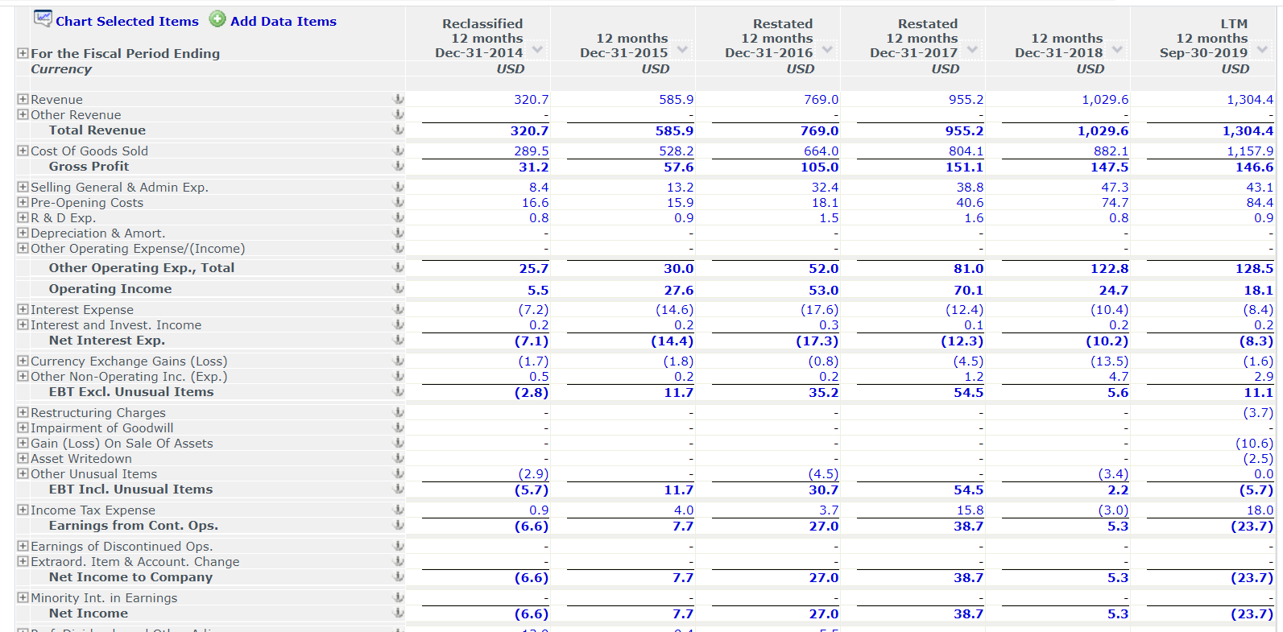
TPIC Income Statement Information

Slide 20
Intrinsic Valuation – DCF Base Case (Bloomberg WACC)
Analyst: Alyssa Allen
Source: TPIC Bull DCF

Slide 21
Intrinsic Valuation – DCF Upside Case (Calculated WACC)
Analyst: Alyssa Allen
Source: TPIC Bull DCF

Slide 22
Intrinsic Valuation – DCF Upside Case (Bloomberg WACC)
Analyst: Alyssa Allen
Source: TPIC Bull DCF

Slide 23
Intrinsic Valuation – DCF Downside Case (Calculated WACC)
Analyst: Alyssa Allen
Source: TPIC Bull DCF

Slide 24
Intrinsic Valuation – DCF Downside Case (Bloomberg WACC)
Analyst: Alyssa Allen
Source: TPIC Bull DCF

